Slide 1
Sarangani Moves Towards Accessible, Responsive, and Technology-Based Education
Ariel C. Lalisan, HT-I
Paraiso Integrated School / Designated Division Information Officer

Slide 2
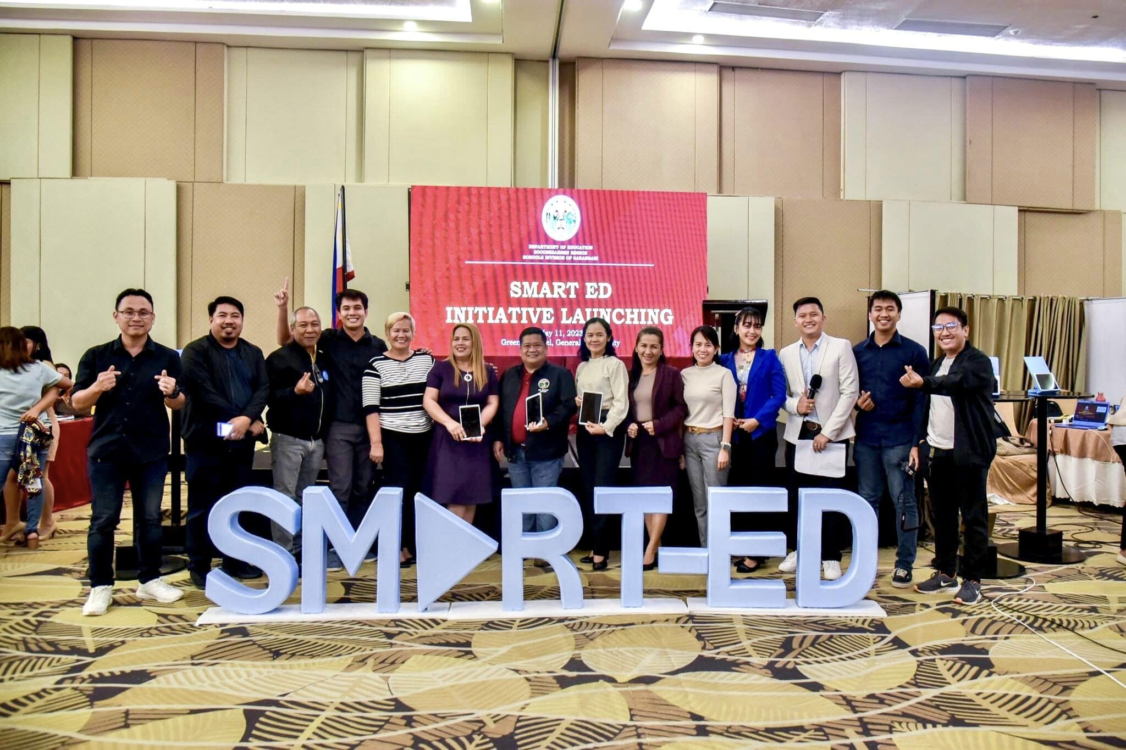

Slide 3
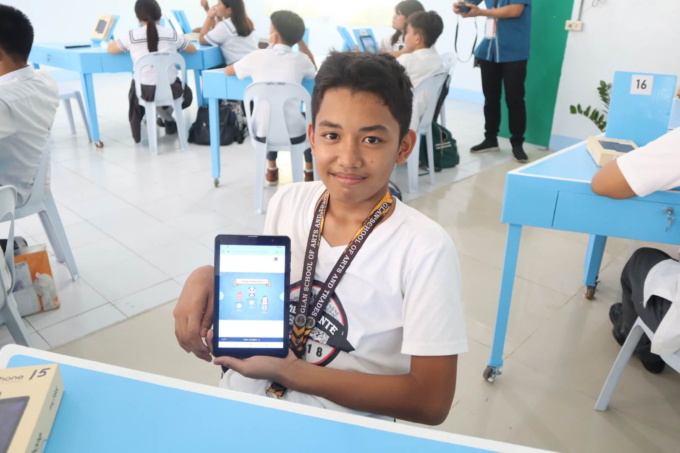
Notes:
To support the implementation of the LMS and the use of our digitized learning resources, we launched the SMART-ED Initiative to provide our schools with the infrastructure and equipment needed to allow more learners to access interactive lessons and activities.

Slide 4
Why SMART-ED?
Section 5 of RA 10533 states that the DepED shall adhere to the following standards and principles:
Learner-Centered
Use of constructivist, inquiry-based, reflective, collaborative, and integrative pedagogical approaches
Global
Allows for contextualization, localization, and indigenization
Section 7:
Continuous Professional Development
Notes:
Our first engagement with the LMS was at the onset of the pandemic. While we were still looking for alternatives to modular distance learning, we built the LRonWHEeLS or the Learning Resources on WiFi Hub for Expanded e-Learning in Sarangani. It is an innovation that allowed our learners to experience e-Learning even if their communities are not connected to the internet.

Slide 5
How SMART-ED teachers use technology
Teachers in SMART-ED Classrooms must be adept in:
Using technology to ACCESS learning resources
Using technology to DEVELOP learning resources
Using technology to DELIVER learning
Using technology to ASSESS learning

Slide 7
ONLINE PLATFORMS
Learning Management System
Google Classroom (http://classroom.google.com)
For interactive simulations/learning experiences:
PhET (http://phet.Colorado.edu) for Science and Mathematics
For interactive lesson delivery:
Nearpod (www.nearpod.com)
Classpoint (www.classpoint.io)
For fun interactive quizzes:
Kahoot (www.kahoot.com), Quizziz (www.quizziz.com),
For assessment:
Google Forms Quiz

Slide 9
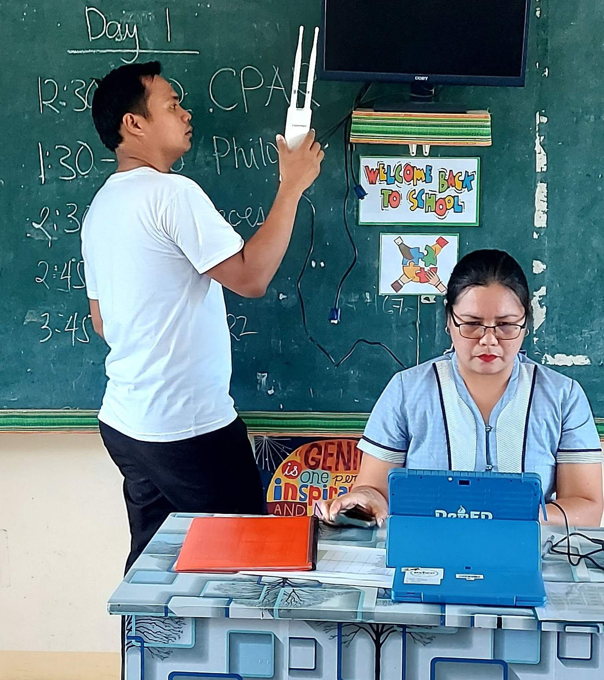
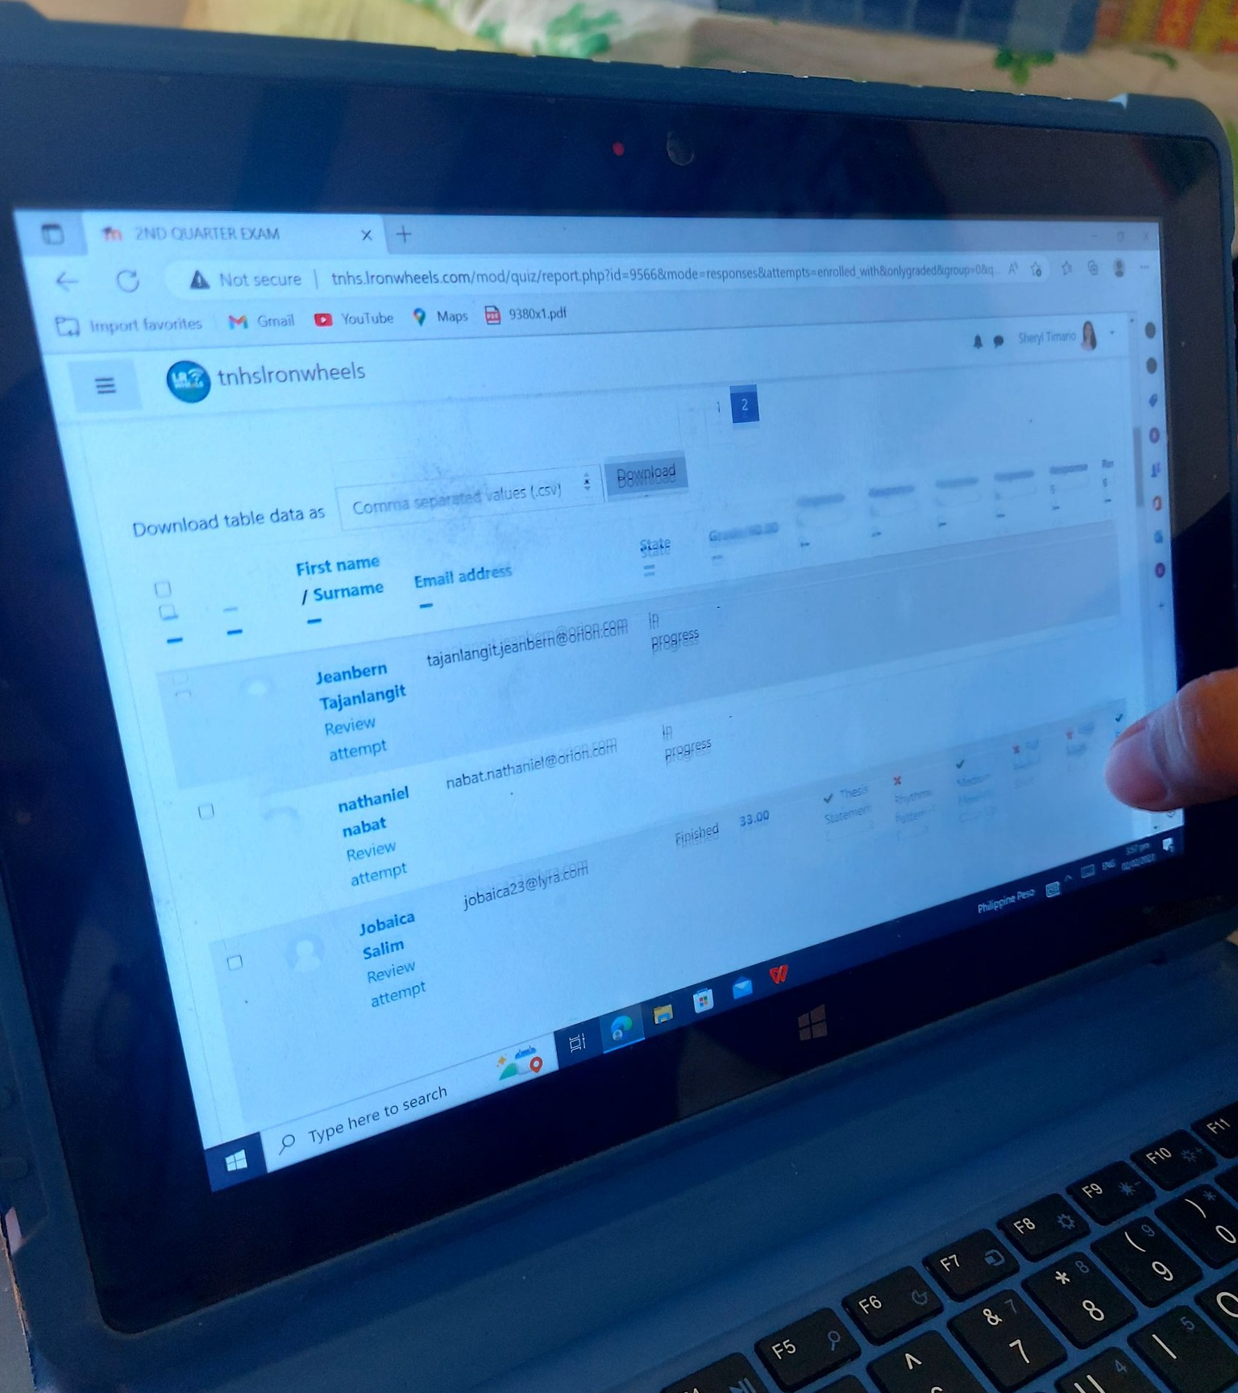
Notes:
However, during the in-person classes, some new challenges were faced. Because there are more learners now in school who are accessing the LMS, we experienced slowing down of access. There were also some classrooms that could be reached by the network, so some learners had to go outside their classrooms to get a better signal. But these problems were addressed by class programming and providing teachers with mobile antennas to widen the reach of the network. Those whose servers whose capacities could not accommodate the number of users, we converted the materials into HTML and Android Package Kits which we installed in their phones.

Slide 12
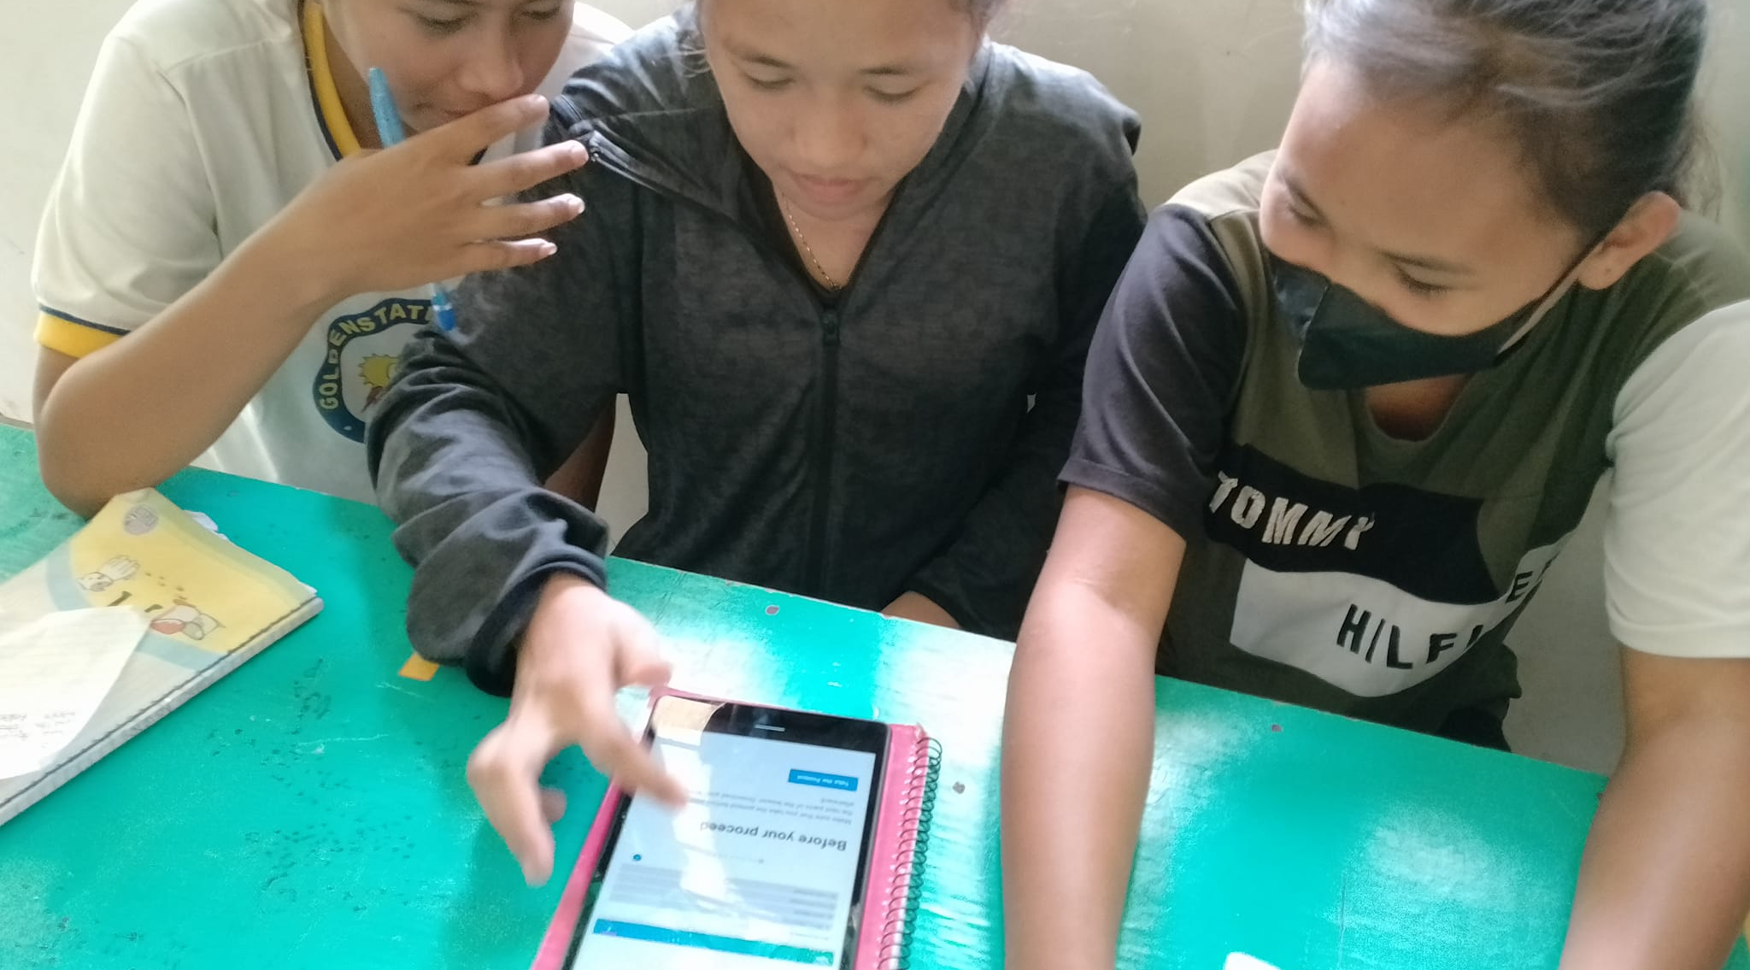

Slide 16
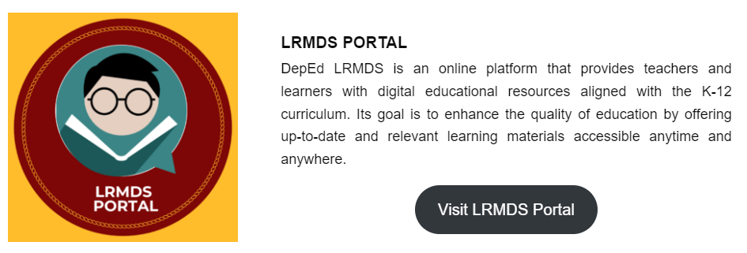
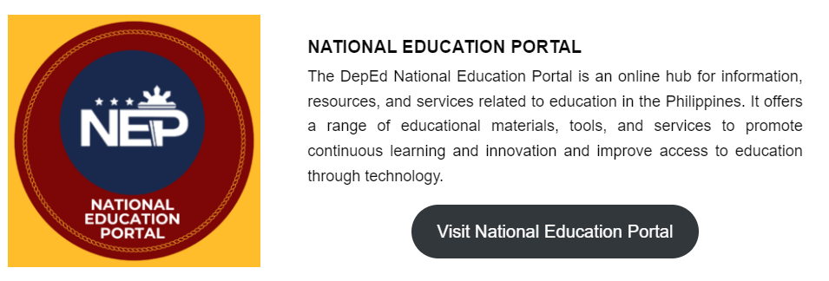

Slide 17
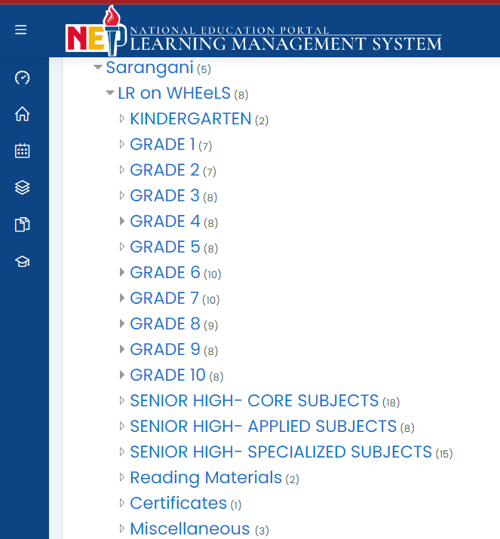
Notes:
We have also leveled up our content by teaching our creators to develop content using Lumi for Education, which outputs H5P. We now have H5P content for almost all subject areas and grade levels in the 3rd and 4th quarter. And we are still planning to continue to transform our content in the 1st and 2nd quarter into H5P.

Slide 18
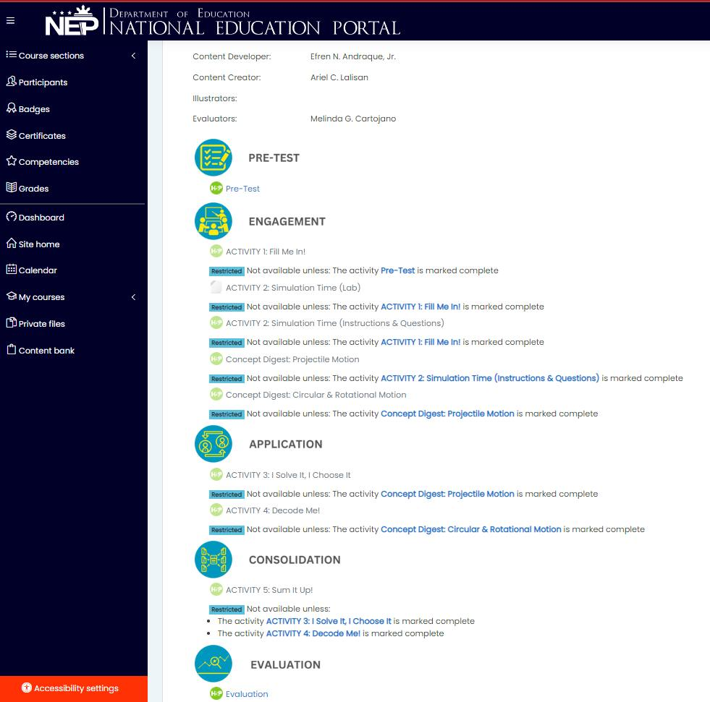
Notes:
We have also leveled up our content by teaching our creators to develop content using Lumi for Education, which outputs H5P. We now have H5P content for almost all subject areas and grade levels in the 3rd and 4th quarter. And we are still planning to continue to transform our content in the 1st and 2nd quarter into H5P.

Slide 19
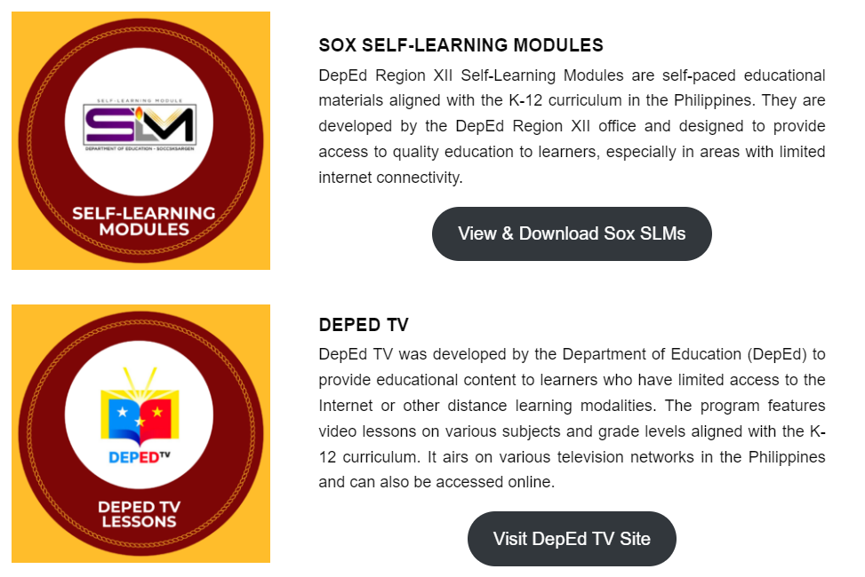

Slide 21
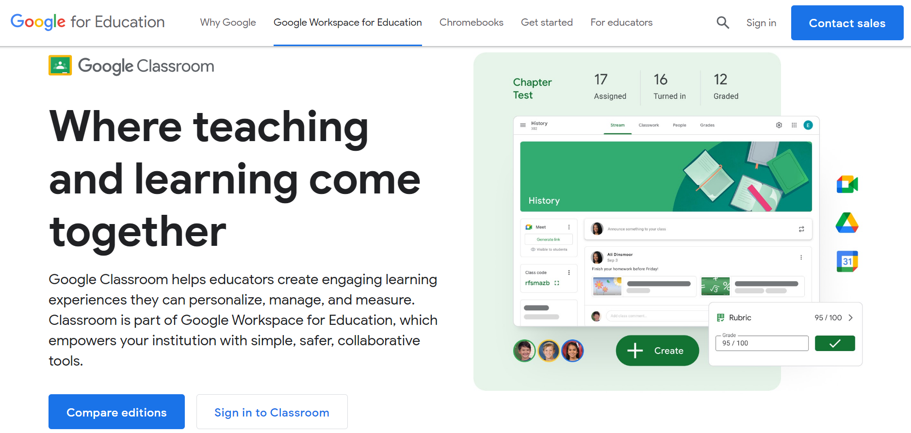
classroom.google.com

Slide 22
www.nearpod.com

Slide 23
www.classpoint.io

Slide 24
phet.colorado.edu

Slide 25
www.oercommons.org

Slide 26
www.prodigygame.org

Slide 27
www.teachertube.com

Slide 28
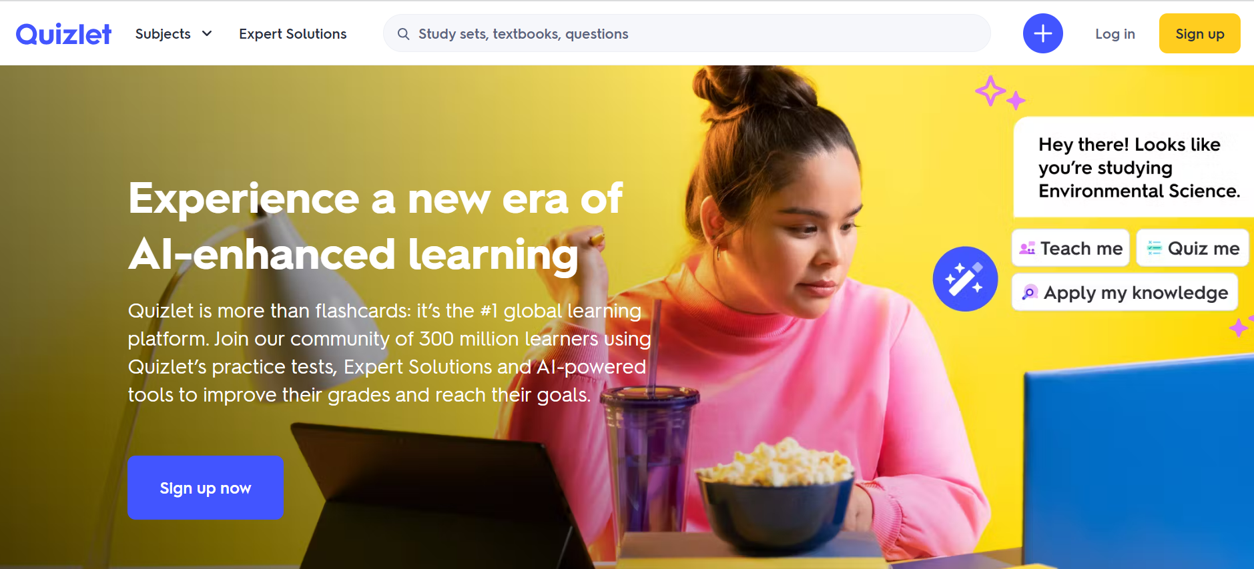
www.quizlet.com

Slide 29
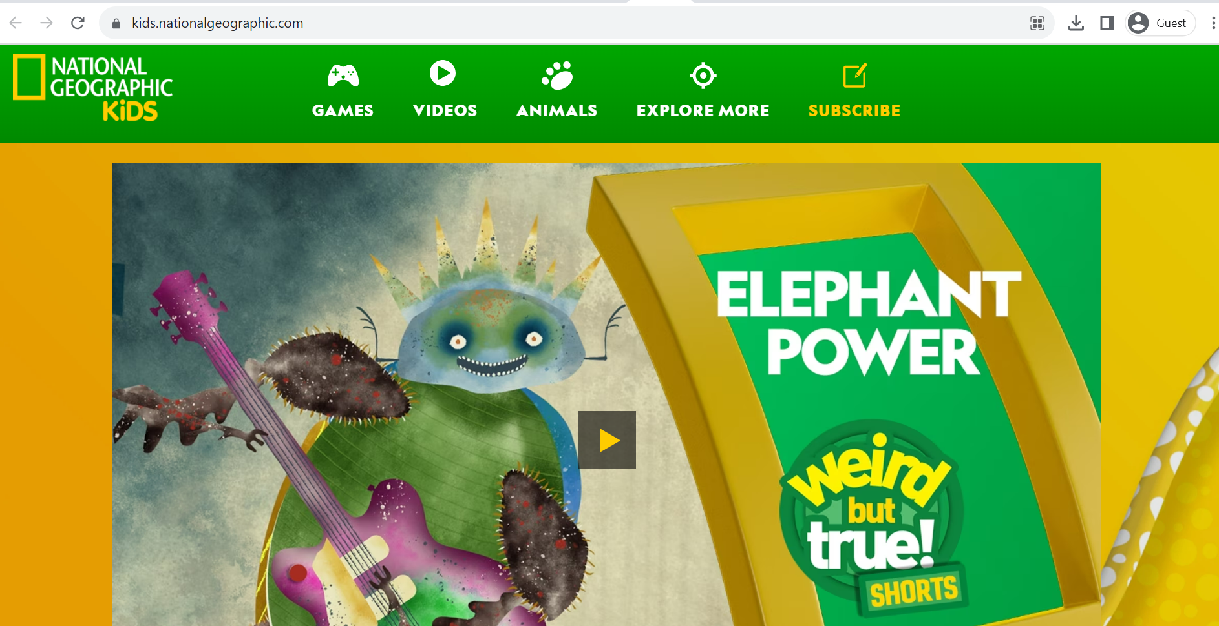
kids.nationalgeographic.com

Slide 30
www.funbrain.com

Slide 31
www.starfall.com

Slide 32
https://www.thekidzpage.com/learninggames/

Slide 33
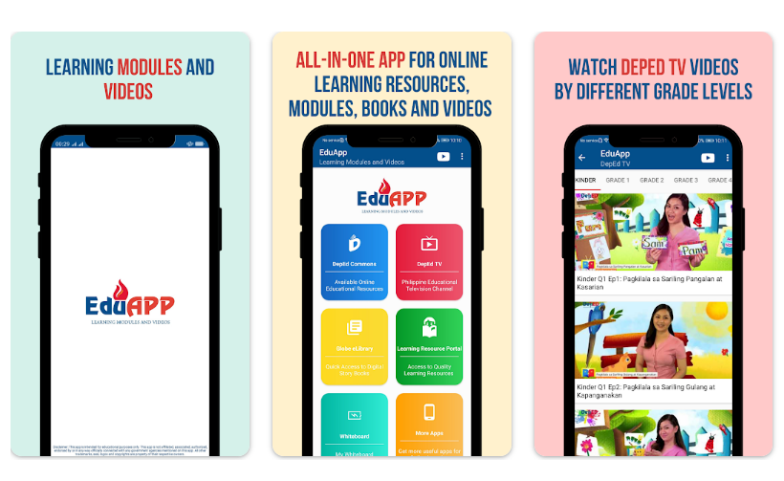
EduApp by ScriptRepublic

Slide 34
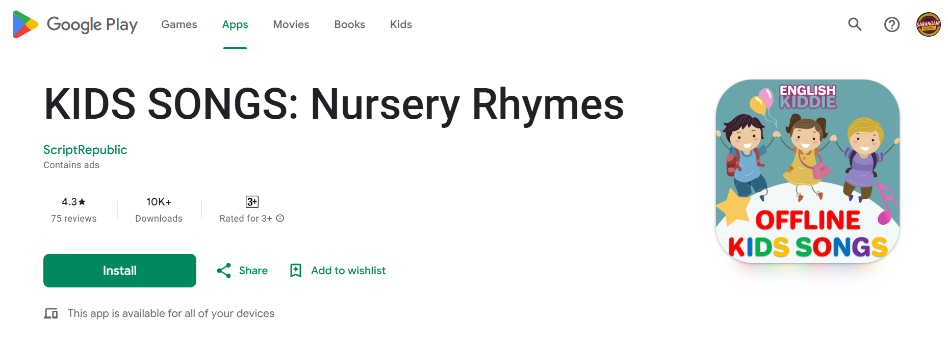
KIDS SONGS: Nursery Rhymes by ScriptRepublic

Slide 35
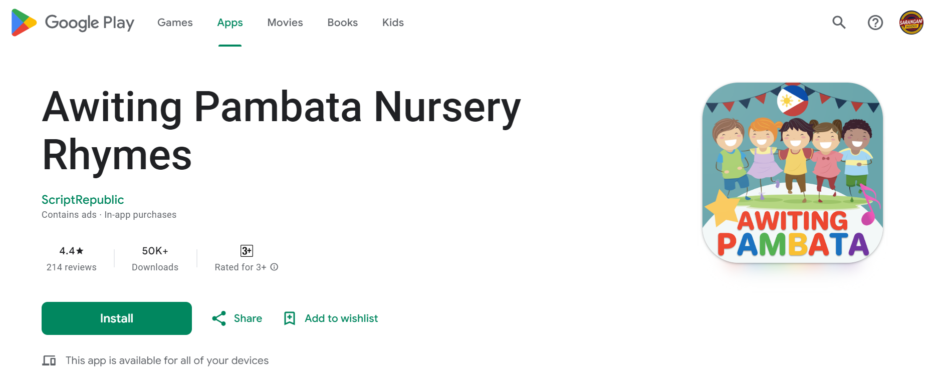
Awiting Pambata Nursery Rhymes by ScriptRepublic

Slide 36
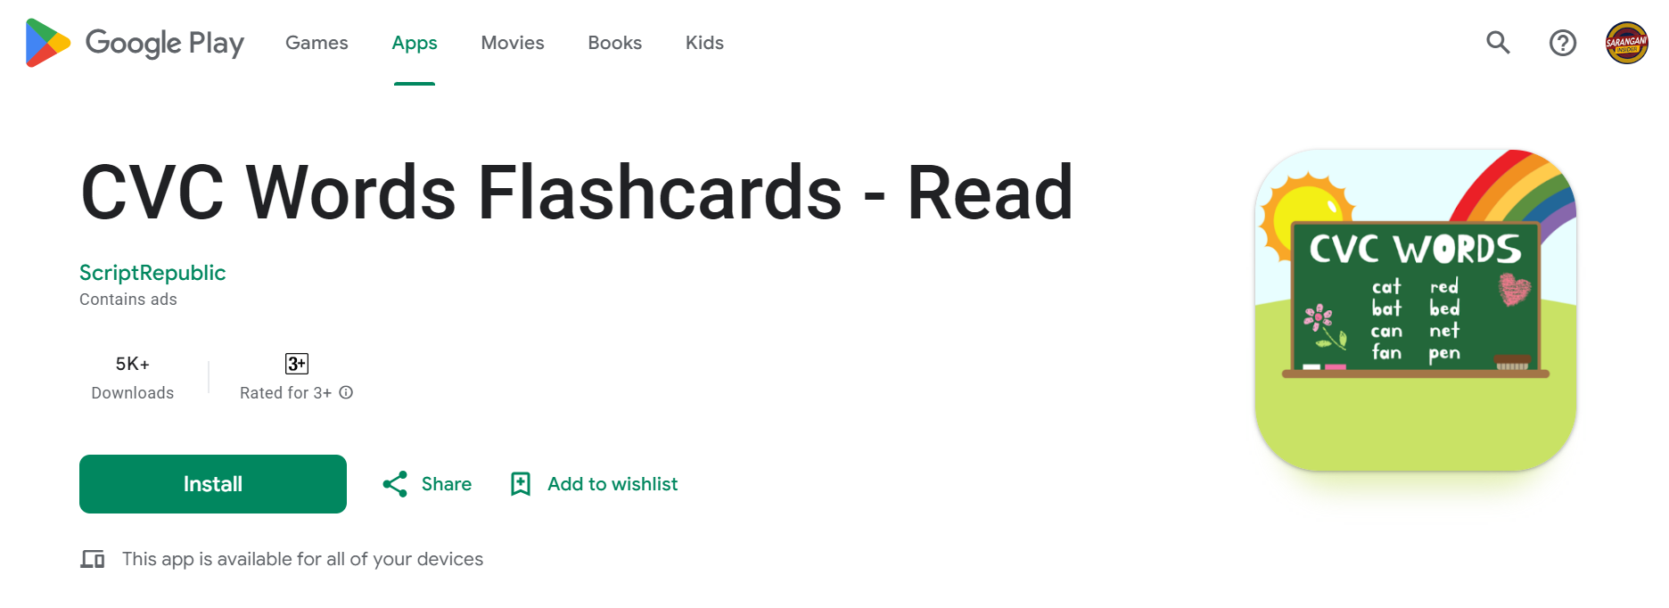
CVC Words Flashcards by ScriptRepublic

Slide 37
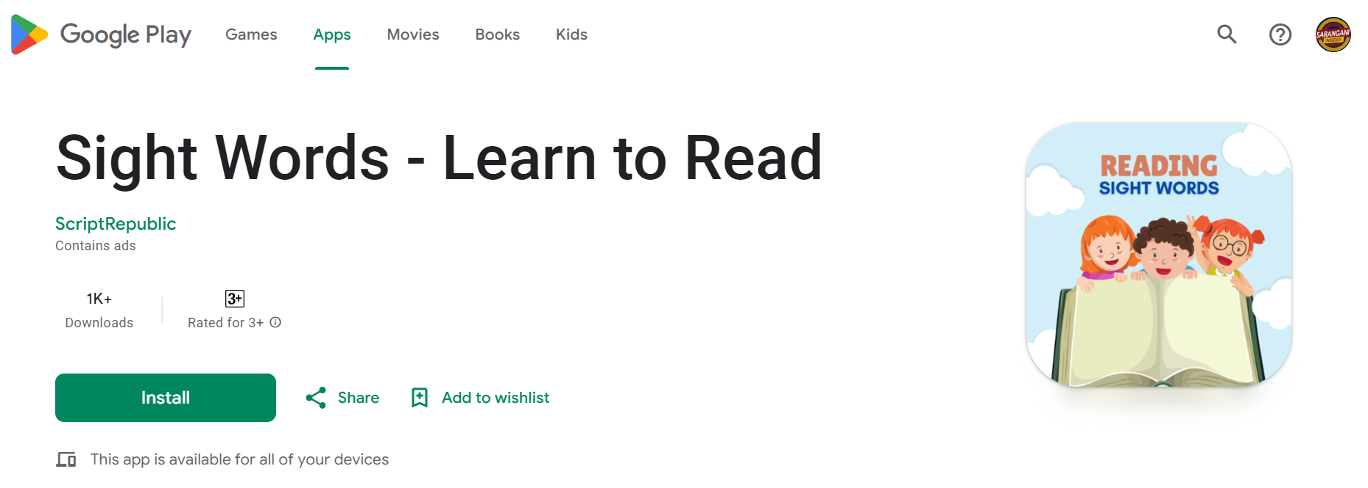
Sight Words – Learn to Read by ScriptRepublic

Slide 38
LINKS
https://depedsarangani.org/smart-ed-initiative/
https://depedsarangani.org/learning-resources/
http://depedsarangani.org/lrow

